Slide 1
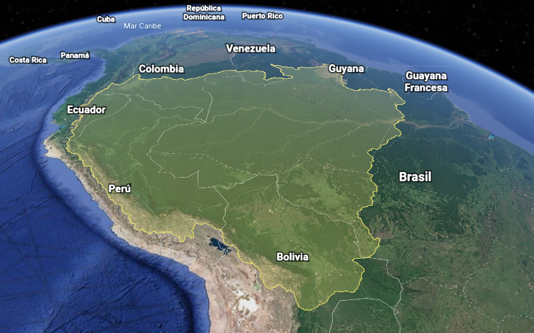

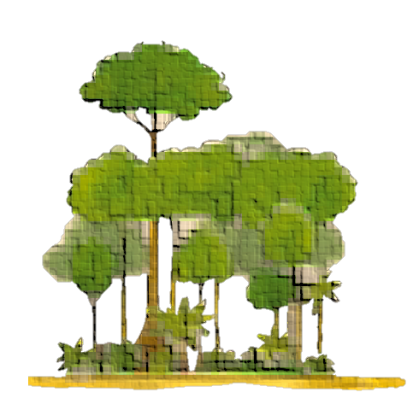

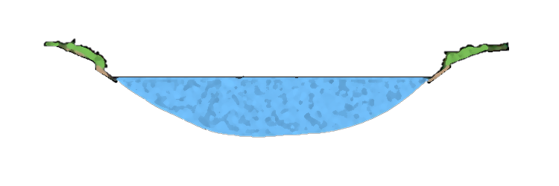
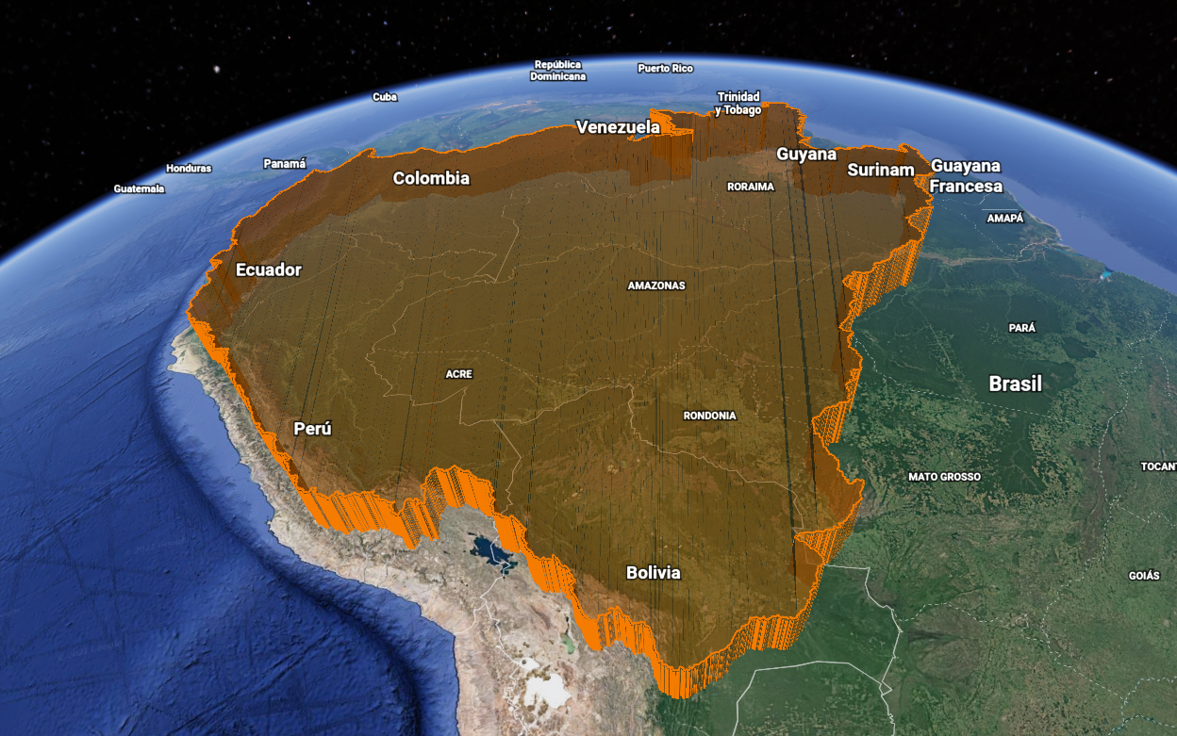
(a)
Land Reservoir (LR)
(b)
Precipitation
Evapotranspiration
Evaporation
Precipitation
Discharge
Vegetation, LULC
Land Reservoir (LR)
Discharge
Shallow subsurface
Land
Deep subsurface
(c)
Land – Atmosphere Reservoir (LAR)
(d)
Atmosphere
Convergence
Moisture Recycling
Land - Atmosphere
Reservoir (LAR)
Discharge
Vegetation, LULC
Convergence
Discharge
Shallow subsurface
Land
Deep subsurface

Slide 2
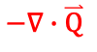
(a)
Land Reservoir (LR)
(b)
Precipitation
Evapotranspiration
E
Evaporation
R
Precipitation
P
Discharge
Vegetation, LULC
Land Reservoir (LR)
Discharge
Shallow subsurface
Land
Deep subsurface
(c)
Land – Atmosphere Reservoir (LAR)
(d)
Atmosphere
Convergence
R
Moisture Recycling
Land - Atmosphere
Reservoir (LAR)
Discharge
$$−∇∙\overset{⃑}{Q}$$
Vegetation, LULC
Convergence
Discharge
Shallow subsurface
Land
Deep subsurface

Slide 3
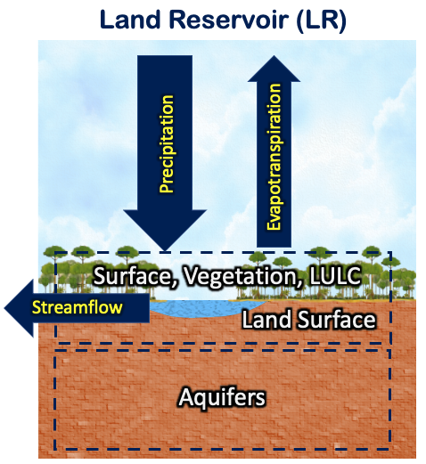
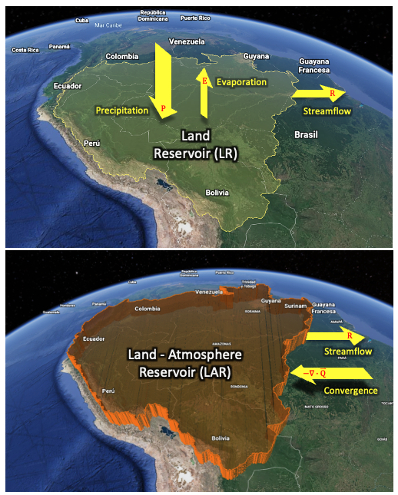
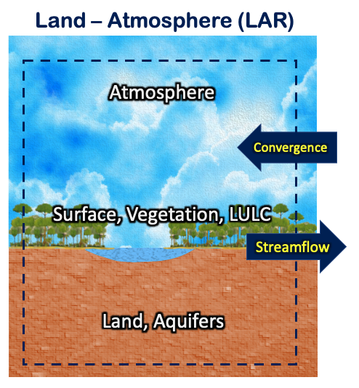

Slide 4
Land Reservoir (LR)
Land – Atmosphere (LAR)
1 col
Ancho: 89 mm
2 col
Ancho: 183 mm
1.5 col
Ancho: 120-136 mm
Atmosphere
Precipitation
Evapotranspiration
Convergence
Surface
Surface
Discharge
Discharge
Land
Land

Slide 5
Land Reservoir (LR)
Land – Atmosphere (LAR)
1 col
Ancho: 89 mm
2 col
Ancho: 183 mm
1.5 col
Ancho: 120-136 mm
Atmosphere
Precipitation
Evapotranspiration
Convergence
Vegetation
Vegetation
Discharge
Discharge
Land
Shallow subsurface
Shallow subsurface
Land
Deep subsurface
Deep subsurface

Slide 7
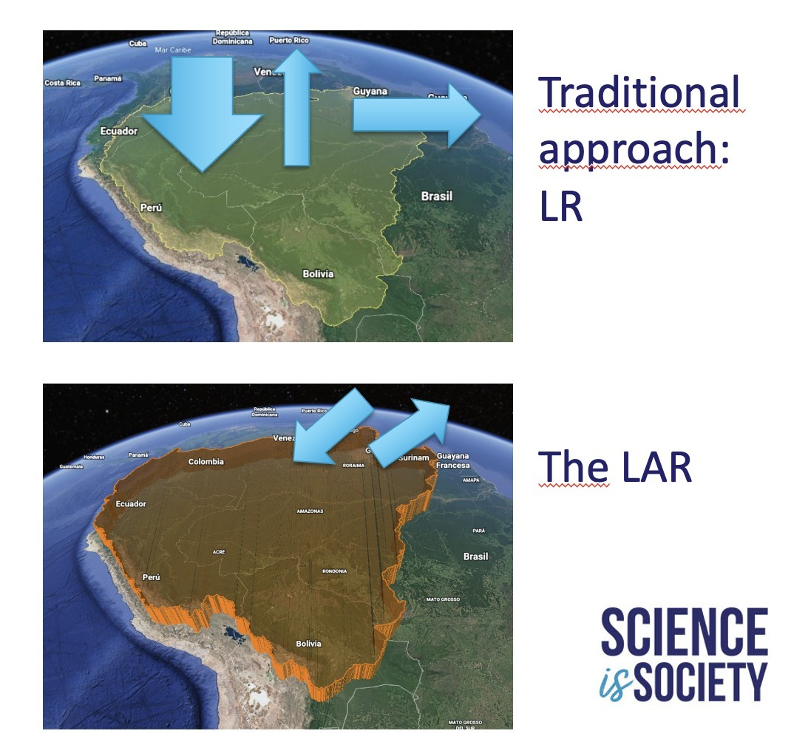
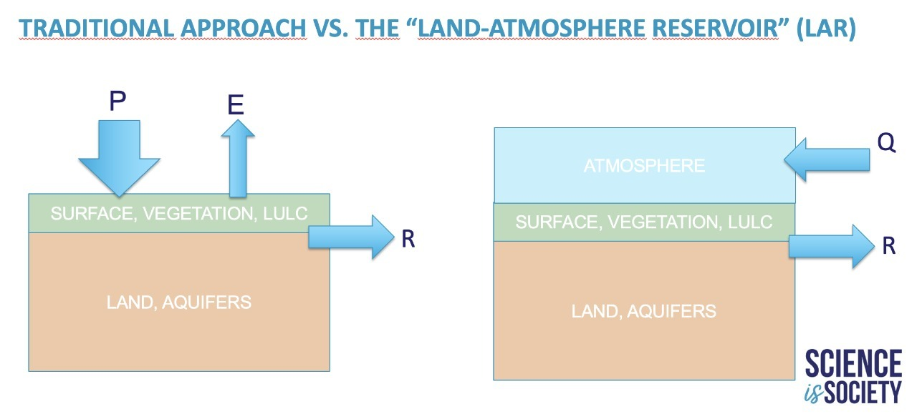

Slide 8
Land
Land Reservoir (LR)
Land – Atmosphere (LAR)
1 col
Ancho: 89 mm
2 col
Ancho: 183 mm
1.5 col
Ancho: 120-136 mm
Atmosphere
Precipitation
Evapotranspiration
Convergence
Land surface
Land surface
Discharge
Discharge
Aquifers
Aquifers
Land
Surface

